Slide 1

VIZAG INSTITUTE OF TECHNOLOGY (Approved by AICTE, New Delhi, Affiliated to JNTUK, Kakinada) Dakamarri, Bheemunipatnam, Visakhapatnam – 531162 Department of Electronics and Communication Engineering PROJECT REPORT ON
IOT BASED ON COAL MINE SAFETY SYSTEM USING NODE MCU
Under the esteemed guidance of:
Mrs.M.THARANGANI M.TECH.
Assistant Professor,
ECE Department,
Vizag Institute Of Technology.
Presented by:
R.LAVANYA (17PC5A0403)
P.SURYA HASINI (16PC1A0427)
P.SRIDEVI (16PC1A0426)
B.HEMALATHA (17PC5A0401)
B.NAVEEN KUMAR (16PC1A0406)
P.VIJAY KUMAR (16PC1A0425)
R.TEJESH (15PC1A0450)
R.SANTHOSH KUMAR (16PC1A0433)

Slide 2
Contents:
ABSTRACT
INTRODUCTION
EXISTING AND PROPOSED SYSTEM
BLOCK DAIGRAM AND DISCRIPTION
COMPONENTS
NODE MCU
FEATURES
AURDINO
PROGRAM
SCREENSHOTS
RESULT
CONCLUSION

Slide 3
Abstract:
The accidents in coal mines are increased day by day. There are numerous life losses of many skilled workers and laborers. There is no advent precaution measure to detect the alarming cause of the coal mine accidents and provide an alert system. Occupational accidents and occupational diseases are common in the mining. The most common causes of accidents in coal mining are firedamp and dust explosions, landslips, mine fires, and technical failures related to transport and mechanization. Thus an automated alarming coal mine accident detection system is employed to rescue and protect the workers from the hazards.

Slide 4
INTRDUCTION:
The accident is any uncertain activity due to unavoidable circumstances and carelessness of some people. This incident is happening continuously all around the world. A large number of workers (approximately 2.3 million) die each year worldwide, 350,000 because of occupational accidents and approximately 2 millions. Production activities consist of main activities such as excavation, ground support, and haulage as well as activities such as electricity maintenance, establishing and managing pressurized room networks, communication and signalization systems, and maintenance and repair of various machines and equipment. Thus they end up with many complications physically.

Slide 5
Existing System:
They are many existing techniques for the communication inside the underground mines.
Thecommunication schemes include GPS,GSM,RFID,Zigbee,Radar sensor network.etc.
There are existing coal mine alert systems that is built using sensors and WSN.
The data rate transmission and governing these data is done at the faster rate during emegency suitations.

Slide 6
Proposed System:
The drastic change in underground environment can lead hazards to the miners.here minimum measure saftey is provided.
So better sensing system is localized.
Radio frequency technology is proposed for better communication.
Inorder to sense and measure the parameter inside coal mine wireless sensor can also be introduced.
The integration of WSN and radio frequency tech. improve safety inside the mines.

Slide 7
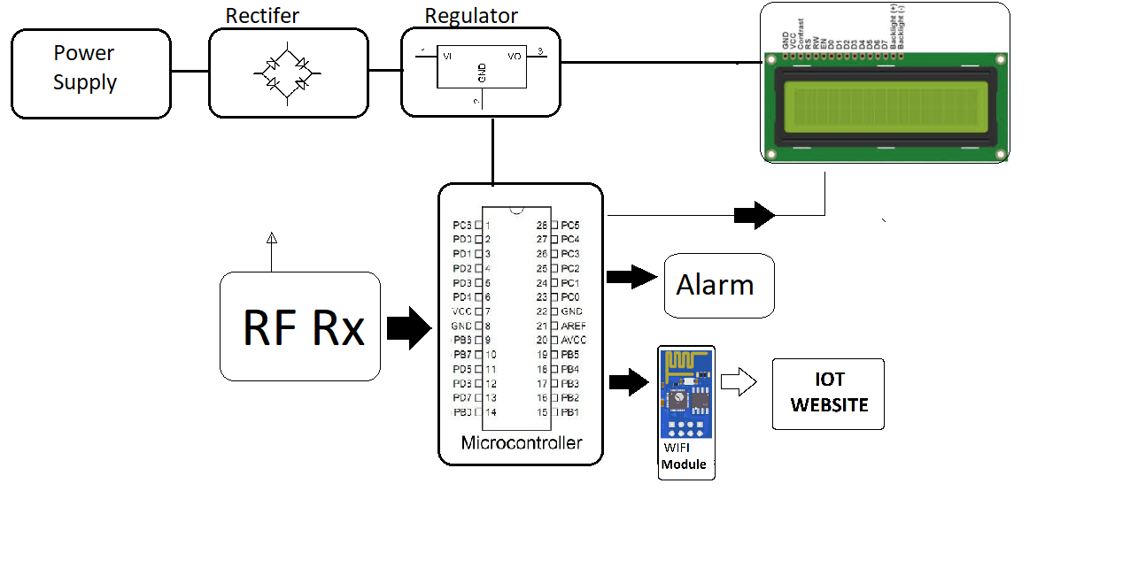
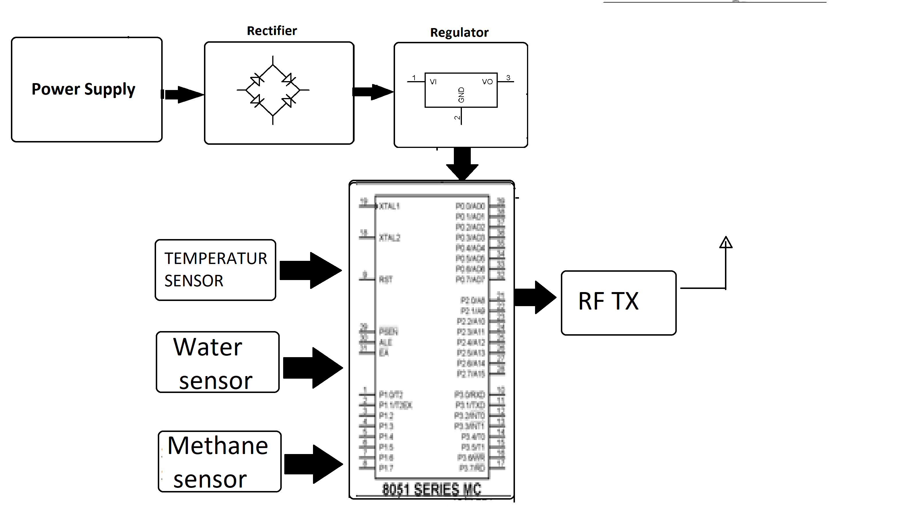
Block Diagram:

Slide 8
Block Diagram Description:
The Temperature sensor is used to measure the mine temperature and humidity sensor measures the humidity level in mining time. The gas sensor is using to find them gas level in mining and the LDR sensor is used to find the light density and if any abnormal value means the microcontroller will send each second value to IOT cloud and electrical devices upon the sensor value. all sensor value is uploaded to the IOt cloud in this method.

Slide 9
Components:
Power supply
Atmega microcontroller
RF Module
Temperature Sensor
Gas Sensors
LCD Display
Resistors
Capacitors
Transistors
Diodes
LED
Buzzer

Slide 10
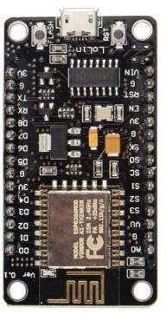
Node mcu:
The Node Micro Controller Unit (NodeMCU) is used as a gateway. It has inbuilt Wi-Fi module which is used to send the sensor data to cloud for storage and analysis.
Also, it consumes less power (3.3v) and is of low cost when compared to other microcontrollers /processors like Arduino and Raspberry pi.

Slide 11
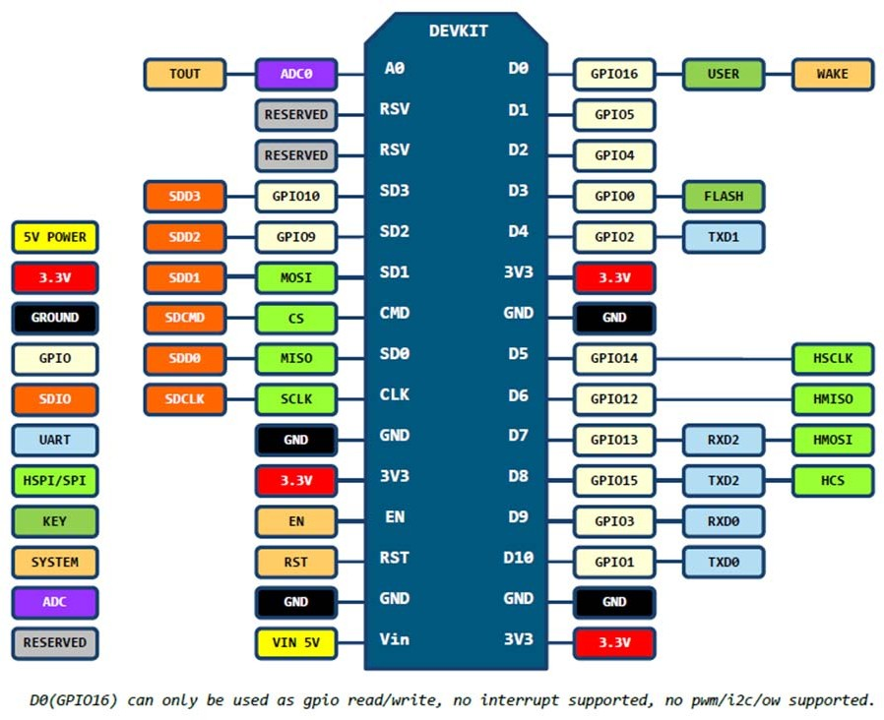
Pin daigram:

Slide 12
Features:
Voltage:3.3V.
Wi-Fi Direct (P2P), soft-AP.
Operating current Average: 80mA
Flash memory attachable: 16MB max (512K normal).
Integrated TCP/IP protocol stack.
Processor speed: 80~160MHz.
RAM: 32K + 80K.
GPIOs: 17 (multiplexed with other functions).

Slide 13
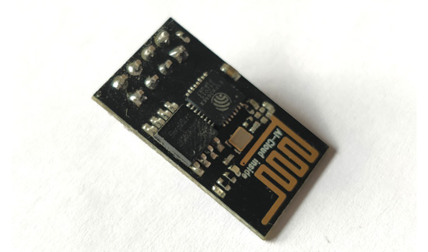
ESP8266:
The ESP8266 is a very user friendly and low cost device to provide internet connectivity.
The module can work both as a Access point (can create hotspot) and as a station (can connect to Wi-Fi).
The chip first came to the attention of Western makers in August 2014 with the ESP-01 module

Slide 14
How to use the ESP8266 Module:
There are many methods but most commonly arduino IDE.
The ESP8266 module works with 3.3V only, anything more than 3.7V would kill the module.
The best way to program an ESP-01 is by using the FTDI board.
One commonly problem with ESP-01 is the powering up problem. So it is important to make a voltage regulator for 3.31v that could supply a minimum of 500mA.

Slide 15
Applications:
IOT Projects
Access Point Portals
Wireless Data logging
Smart Home Automation
Learn basics of networking
Portable Electronics
Smart bulbs and Sockets

Slide 16
FEATURES:
Processor: L106 32-bit RISC microprocessor core based on the Tensilica Xtensa Diamond Standard 106Micro running at 80 MHz^{[5]}
Memory:
32 KiB instruction RAM
32 KiB instruction cache RAM
80 KiB user-data RAM
16 KiB ETS system-data RAM
External QSPI flash: up to 16 MiB is supported (512 KiB to 4 MiB typically included)
IEEE 802.11 b/g/n Wi-FI

Slide 17
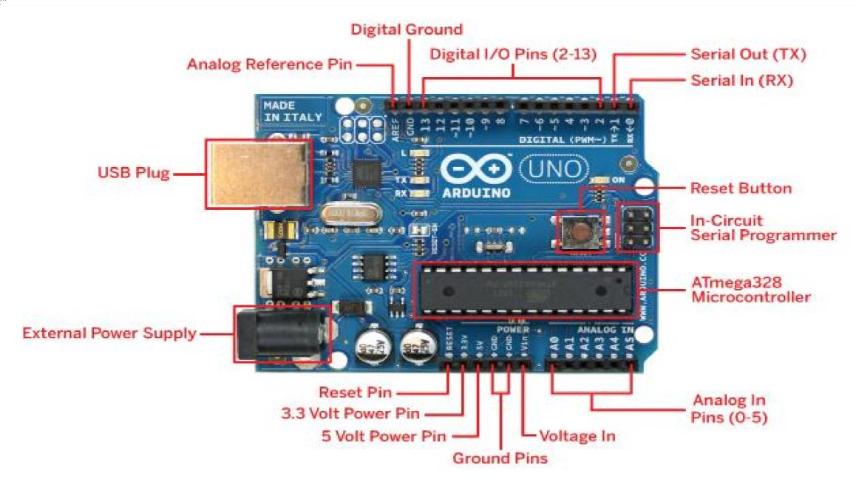
ARDUINO:
The Arduino Integrated Development Environment (IDE) is a cross-platform application (for Windows, macOS, Linux) that is written in functions from C and C++^{[2]}
Programs written using Arduino Software (IDE) are called sketches.
It is used to write and upload programs to Arduino compatible boards.

Slide 18
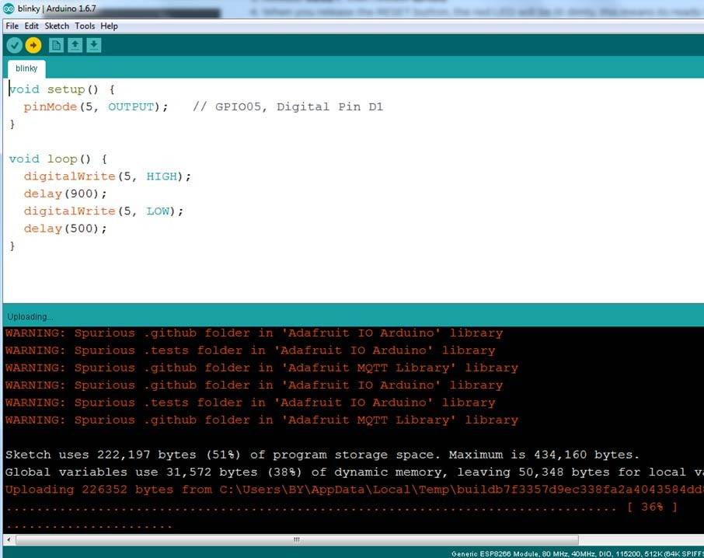
BLINK TEST:
The image to the left shows an example of a simple sketch that blinks an LED. It turns it on, waits a second, turns it off, waits a second and loops until the Arduino is turned off.

Slide 19

Blynk for NodeMCU:
Blynk is a Platform with IOS and Android apps to control Arduino, Raspberry Pi and the likes over the Internet.
It’s a digital dashboard where you can build a graphic interface for your project by simply dragging and dropping widgets.

Slide 20
Steps:
Blynk App
Create a Blynk Project
Add Widgets To The Project
Upload The Firmware
Stand Alone Programming Code
Execution
Output

Slide 21
PROGRAM:

Slide 23
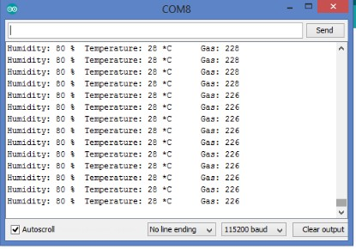
Screenshots:
screenshots representing the values and the message displayed on the serial monitor

Slide 24
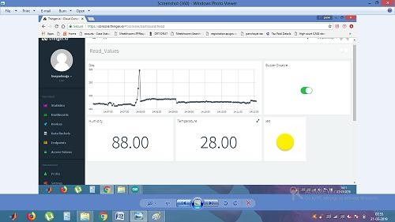
screenshots values of all the sensors displayed on the Cloud using widgets.

Slide 25

Screenshots showing the alert messages to the email is there is a chance of catching the fire

Slide 26
Problem sTATEMENT:
Coal mining has been a very dangerous activity.
The major problem identified in that there are numerours accidents occuring in the coal mines due to improper maintanance and inadequate monitoring of the mining activities.

Slide 27
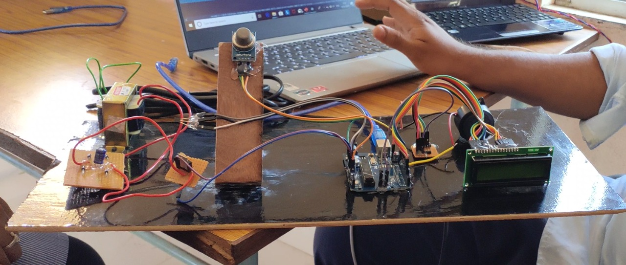
Result: In this system we mainly have monitoring and controlling systems monitoring system we monitor all the data from different sensors
Set up of coalmine safety system

Slide 28
Conclusion:
Implementation of Coal mine safety system is implemented using Fire sensor, Gas sensor, LDR sensor, DHT11 sensor to increase the safety of the workers in the coal mine and to prevent them from danger, By using this system constant checking of the coalmine and alerting the worker is done by using Thinger io.
The system is cost-effective and efficient

Slide 29

Any Queries …??

Slide 30
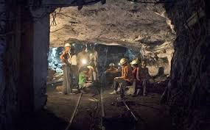
Thank you…

